Slide 1
Face Attribute Recognition Using Deep Learning Models

Slide 2
Motivation
For my final project, I worked on a computer vision task using the CelebA face dataset.
The main goal of the project was to build a deep learning system that can detect whether a person is wearing eyeglasses or not.
I also added a visual similarity matching part to compare facial attributes such as hair, eyes, nose, mouth, smile, beard, and eyeglasses.
This project connects to class topics such as Deep Learning, Neural Networks, Computer Vision, CNNs, Transformers, Explainable AI, and Robustness Testing.

Slide 3
Dataset and Data Split
I used 8,000 face images from the CelebA dataset.
The target label was Eyeglasses.
Each image was resized to 64 × 64 pixels before training.
I split the dataset into:
75% training data 25% testing data
I used stratified splitting so both training and testing sets had a similar percentage of Eyeglasses and No Eyeglasses images. This was important because the dataset was imbalanced.

Slide 4
Data Preprocessing
Before training, I applied preprocessing steps to prepare the images.
Resize to 64 × 64 pixels This made all images the same size.
RandomHorizontalFlip This created slightly different versions of training images and helped improve generalization.
ToTensor This converted images into tensor format for PyTorch.
Normalize with mean = 0.5 and std = 0.5 This scaled pixel values around approximately -1 to 1, which helped the model train more smoothly.

Slide 5
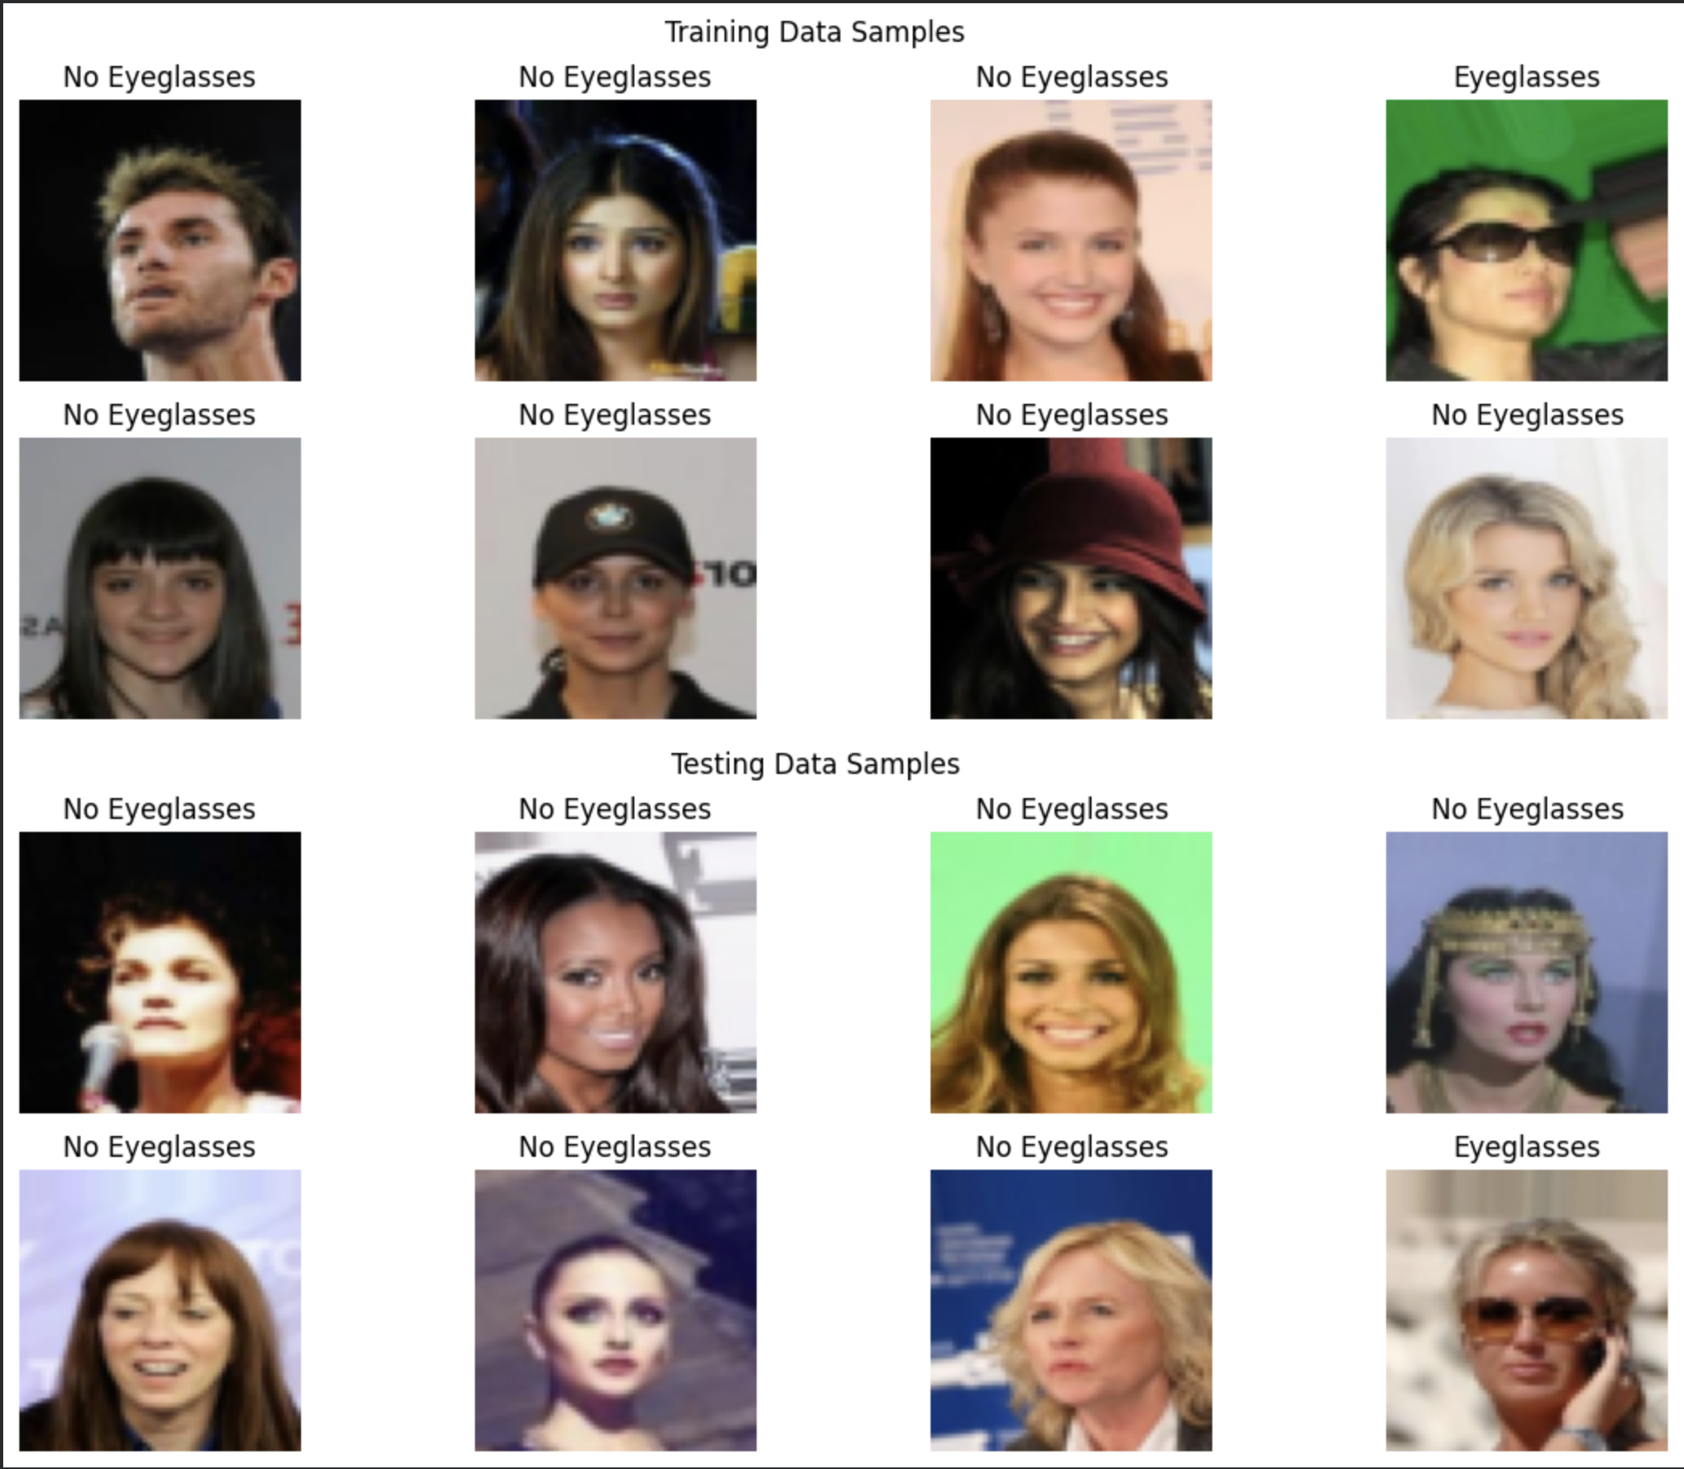
Data Images

Slide 6
Models Compared
I compared three models:
1. MLP Neural Network A simple baseline model.
2. CNN Image Recognition Model A strong computer vision model that learns local visual patterns.
3. Vision Transformer-style Model A modern transformer-based image model that uses image patches and self-attention.
I used these three models to compare a simple approach, a traditional computer vision approach, and a modern AI approach.

Slide 7
Training Settings
I trained each model using the same settings for fair comparison.
Epochs: 10 Learning rate: 0.001 Best model selection: Highest F1-score An epoch means one full pass through the training dataset.
The learning rate controls how much the model updates its weights.
Adam was used because it is stable and commonly used in deep learning.

Slide 8
Class Imbalance Handling
No Eyeglasses: 5603 Eyeglasses: 397
Most images were No Eyeglasses, so accuracy alone could be misleading.
To handle this, I used class weights in CrossEntropyLoss.
Class weights:
No Eyeglasses: 0.5354 Eyeglasses: 5.2897
The Eyeglasses class received a higher weight so the model would not ignore it.

Slide 9
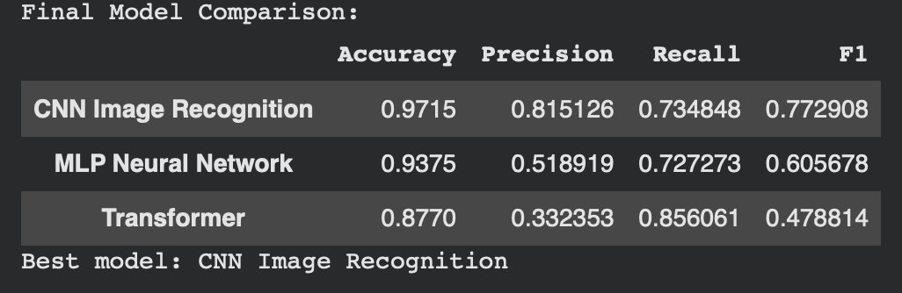
Evaluation Metrics and Results
Final CNN Performance: • Accuracy = 97.15% • Precision = 81.5% • Recall = 73.5% • F1 Score = 77.3%

Slide 10
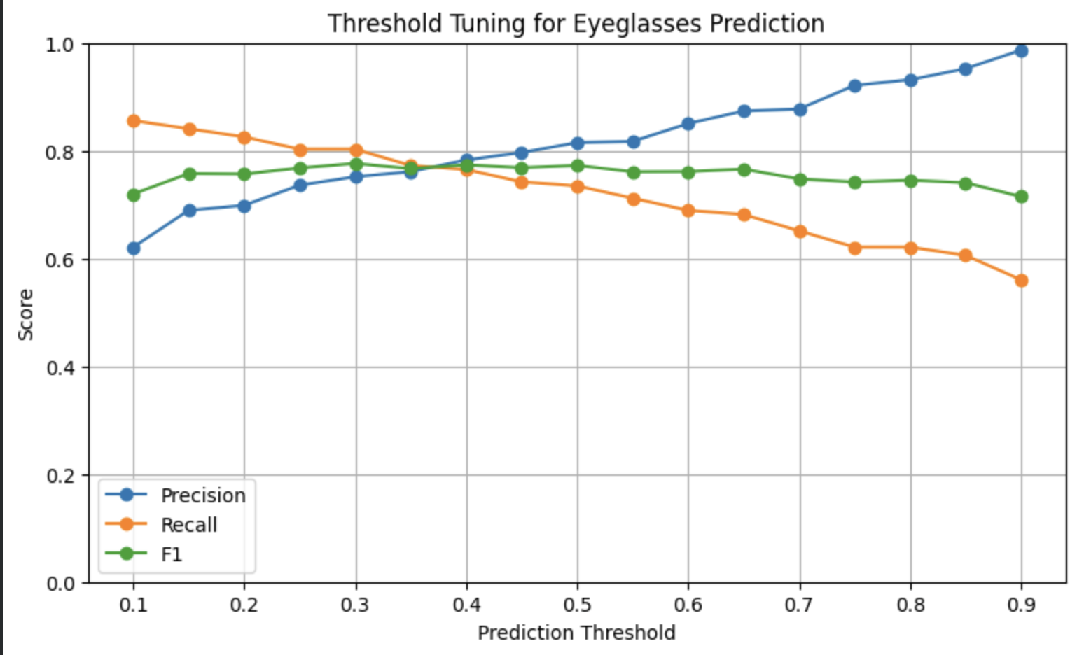
Threshold Tuning and Improvement
I tested thresholds from:
0.10 to 0.90
with step size:
0.05
The best threshold was:
0.30

Slide 11
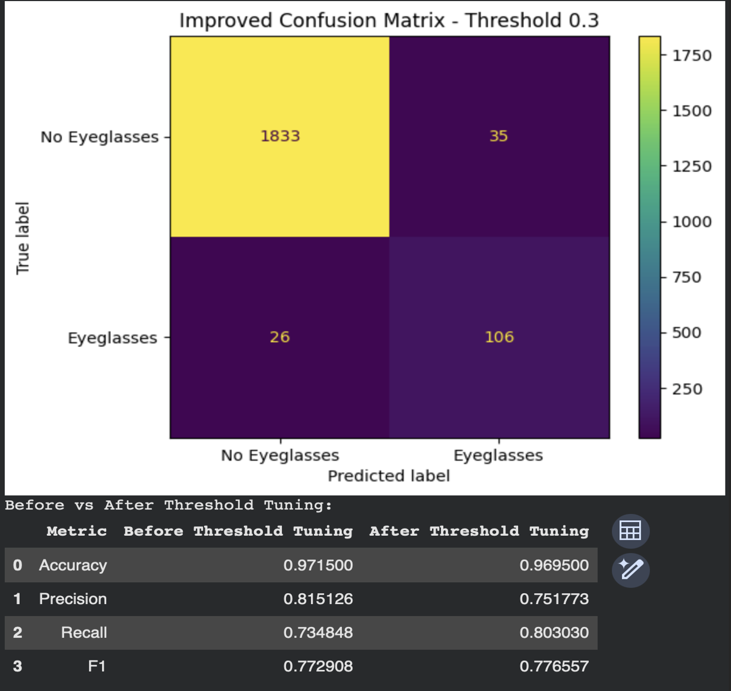
After Threshold Tuning

Slide 12
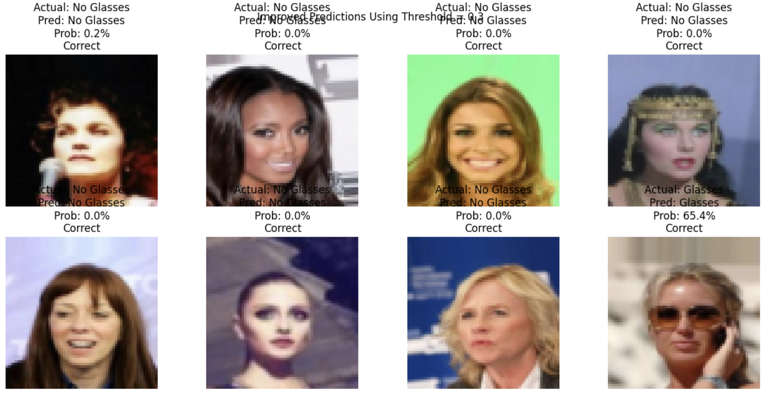
Result

Slide 13
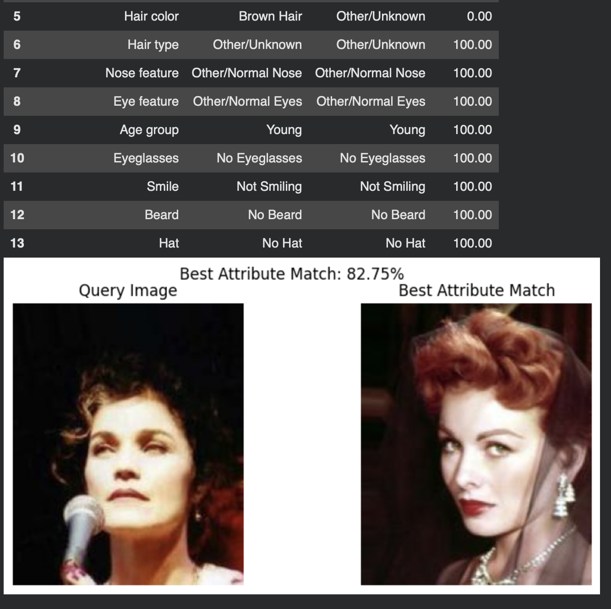
Similarity Matching,
I compared regions such as:
Hair region Eyes region Nose region Mouth region Full face region

Slide 14
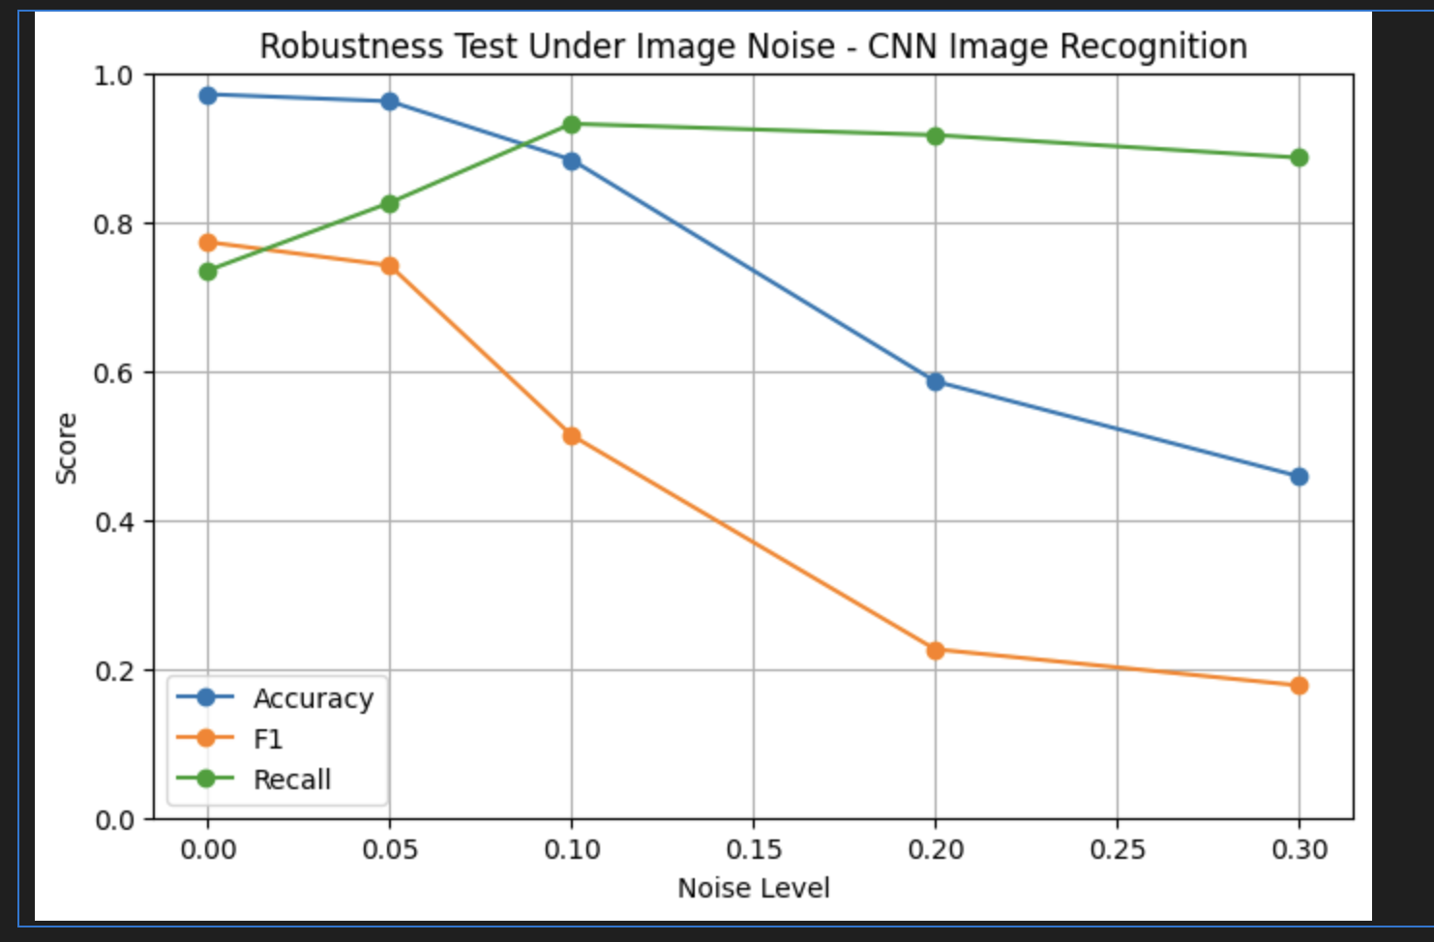
Noise testing
Noise testing with noise levels 0.00, 0.05, 0.10, 0.20, and 0.30 to test robustness.

Slide 15
